Slide 1
Architecting Big Data Solutions
Notes:
Suggested introduction:
Faced with _______
We did _______
And discovered_______

Slide 2
Agenda
What is Big Data?
Big Data Ecosystem
Lambda Architecture
Cortana Analytics Suite
Bringing it all together…
Notes:
Our talk today will discuss the challenge with approaching new solutions using traditional models. We’ll discuss the Lambda Architecture and how it addresses a host of new solutions by challenging traditional processes. Finally, we’ll bring it all together with what I hope will be an eye-opening demonstration. At the end of this talk, you’ll have a much better idea about some of the opportunities for Big Data in the cloud.

Slide 3
What is Big Data?
"Extremely large data sets that may be analyzed computationally to reveal patterns, trends, and associations, especially relating to human behavior and interactions" –Oxford Dictionary
When do I need Big Data?
Volume
Velocity
Variety
Notes:
Big Data is a buzz word that is used a lot now days, and can be quite a complex subject. From a high level, I like the definition given here, but let’s discuss the origin of Big Data to give some context on why you care about Big Data. In the past, when working with large data you would scale up your storage and compute power on your database’s machine; however, as companies like Google and Yahoo discovered, you could only go so far where you reach the limits of scaling up and need to spill into other machines and require sharding/partitioning methods. Partitioning can help to a point, but these companies needed a way to have massive parallel processing with thousands of nodes that just wasn’t possible with traditional databases.
Born from a group of people at Yahoo!, an MPP solution called Hadoop allowed for scalable-out compute (MapReduce) and storage (HDFS) on commodity hardware. With Hadoop you could keep adding infinite nodes to your cluster and work could be equally distributed across the system in parallel.
The question is often asked, “When do I need Big Data?”. The answer comes with the three V’s, “Volume”, “Velocity” and “Variety”.
For Volume, if you are dealing with Terabytes or even Petabytes of data the project is usually a good candidate for a Big Data framework. This is due to the need to have a large amount of parallel compute across your cluster in order to work with the data in a reasonable amount of time. Traditional relational database systems become incredibly expensive for clustered environments and many times require custom appliances to run them. Big Data frameworks like Hadoop can run on commodity hardware and are built on open-source software which is freely available.
For Velocity, if you need to ingest thousands to millions of events a second you can use Big Data frameworks (Spark Streaming/Storm) to handle that load and have the same access to all of your data to analyze in near real-time.
For Variety, if you have a diverse set of unstructured data such as log files, documents, video or images, then Big Data frameworks can give you a centralized place to store and process the data with linear compute and storage options.

Slide 4




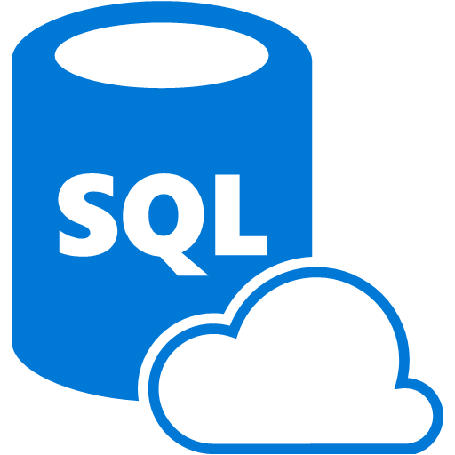











The Old and the New Data Processing
Extract
Transform
Load
OLTP
…
ETL Tool
(SSIS, etc…)
BI Tools
Original data
Transformed data
EDW
(SQL Server, Teradata, etc)
Data Marts
ERP
LOB
Scale-out storage & compute
(HDFS, Blob Storage, etc)
Data Lake(s)
Dashboards
Apps
Ingest
Original data
Streaming data
Transform and Load
Notes:
The problem with EDW in the past is that rules change. If you start to process left to right, this becomes fragile and the data is stale at that point. If you did the rule based on quartiles, you don’t rerun the predecessor. A continued challenge with EDW is limited compute and storage capacity. Traditional analytics projects are notoriously long, complex, and costly. Successful EDW projects can yield tremendous value, and we are not proposing that you discard that value.
Your company has made investments in various tools. You can continue to leverage these tools, even offload the complex processing to cloud to reduce the size of data sets, making those tools more efficient. There are opportunities for new tools that enable new scenarios.
The traditional enterprise data warehouse doesn’t account for the rapidly changing needs of various data sources, and often cannot adapt quickly to accommodate semi-structured or unstructured data. This is where new models such as Hadoop File System coupled with scale-out storage become incredibly valuable. Where traditional warehousing projects are time-consuming and cost in terms of resources, in the cloud, you can spin up an entire new cluster and reprocess the entire past 24 hours of data. You can shut down the cluster when not in use.
Finally, there are new types of data to be processed using streams that differs from the past. We can use technologies to transform and load in near real time to feed analytics solutions.
This is not an either/or proposal. We propose that there’s an opportunity to do both, and this is the benefit of the cloud.

Slide 5
The Big Data Ecosystem
Notes:
Let’s start with the main Big Data players to give context of where lot’s of this started, and then go into what it has evolved to since then.

Slide 6



Major Hadoop Big Data Platforms
Allied Market Research estimates the global Hadoop market to grow from $2 billion in 2013 to $50.2 billion by the year 2020.
Notes:
In the 2004, and engineer named Doug Cutting was the architect of a distributed compute and storage framework called Hadoop. Doug also developed the famous Lucene search technology, which is the core of some famous search frameworks like Elasticsearch and Apache Solr. Over the next few years companies like Cloudera, Hortonworks and MapR emerged with their own distribution of Hadoop and started dominating the market. These companies each have valuations between $1 - $5 billion and are growing in triple digit percentages each year.
So why is this important to Service Integrators? Well according to Allied Market Research, the global Hadoop market is estimated to grow from $2 billion in 2013 to $50.2 billion by the year 2020—that’s a ton of money to be made so if you don’t have skills in the Big Data market you should start learning now.
But why are many companies reluctant to jump into Hadoop? This is partly because the complexity of the Hadoop ecosystem, as shown in the next slide.

Slide 7





Ambari / Cloudera Manager / Cloudera Director
Cluster Management and Monitoring UI
Sqoop
RDBMS Exchange
Spark
SQL / Streaming
Impala
Fast SQL Querying
Pig
Scripting / ETL
Storm
Streaming
HIVE
SQL Language
Oozie
Workflow / Automation
Solr
Search
Mahout
Machine Learning
HBASE
Columnar Store
Hadoop Ecosystem
Zookeeper
HA / Distributed Coordination of Resources
YARN (MapReduce V2)
Yet Another Resource Negotiator / Manager
Flume
Log Collector
HDFS
Hadoop Distributed File System
Notes:
The Hadoop ecosystem is quite complex and has numerous projects that each facilitate a different function. Is it any wonder that people see all the animal names and run away because it’s so much to tackle? It takes some very specialized skills to be able to setup, maintain and optimize a Hadoop cluster. This slide isn’t meant to scare you, but to help you appreciate all the things that go into working with a Big Data framework.

Slide 8

Azure HDInsight
Hadoop in Azure
Massively Parallel Processing (MPP) managed Hadoop cluster
Spark SQL for real-time queries from in-memory caching
Storm and Spark Streaming for near real-time processing of IoT
HBase as a columnar NoSQL transactional database
Hive SQL queries for batch processing
HMaster
Coordination
Name Node
Region Server
Region Server
Region Server
Region Server
Job Tracker
Data Node
Data Node
Data Node
Data Node
Task Tracker
Task Tracker
Task Tracker
Task Tracker
Notes:
In order to simplify the complex framework that Hadoop has become, Microsoft teamed up with Hortonworks to create a fully managed Hadoop cluster in Azure known as HDInsight. HDInsight allows you to specify how many nodes you want, the type of cluster, and whether you want it on Windows or Linux. HDInsight opens up MPP capabilities in the cloud without having to setup your own cluster on-premises or via IaaS. It takes around 1-2 minutes to choose and configure the settings, and then within 15-20 minutes you have a cluster preconfigured and ready to start pushing data into and running distributed queries against in.

Slide 9
When Do I “Do Big Data”
Every project can now benefit
Lowered barriers to entry
Don’t just move on-prem to cloud
Choose projects that make sense
Notes:
Instead of looking at “Big Data” as a big project similar to previous analytics projects that span months or years, every project can now benefit from Big Data concepts to unlock data potential. This is because the on-demand compute model of the cloud combined with scale-out storage in the cloud makes resources available and at a cost unlike ever before.
Don’t look at Big Data projects as something you pick up from on-premises and move, but rather as a new component of a current project. You can now build a public web site and perform analytics on web log data, incorporate social data, and determine customer churn without creating a huge analytics effort afterward. Born-in-cloud data is a great place to start.
Choose projects that make sense. What value do you get of moving your entire Big Data environment to the cloud? Instead, start with new projects. Start with projects that make sense. The key message is that you will realize more value if you don’t try to lift and shift your old environment.
As an example, one customer had a Hadoop cluster on-premises that cost them over a million dollars for all the compute and storage that it required, not to mention all the maintenance the infrastructure required. The customer moved their core process, combining terrabytes of gas meter data and processing it nightly, to HDInsight. The result was a small set of combined data made available in daily increments, and the total solution cost them less than $50K annually. This is just a single example of where Big Data in the cloud makes a lot of sense.

Slide 10
Web Log Processing and Big Data
Notes:
Let’s show an example of using HDInsight to process web logs.
To demonstrate some of the Lambda concepts, we will show how to leverage cold path processing using batching and consuming with existing tools. This demonstration also shows an important point: Big Data doesn’t have to be a project unto itself, it can be part of every project. Our scenario is processing web log data. We will show how easy it is to partition log data from web sites to identify usage per day of our site, and even determine what sites are linking to pages that no longer exist.

Slide 11
Lambda Architecture

Slide 12
Lambda Architecture – High Level View
Batch layer
All data
Precompute views
Batch ingest
Serving layer
Partial aggregate
Partial aggregate
Partial aggregate
New data stream
Merged view
Batch views
Real-time data
Real-time views
Buffered ingest
Speed layer
Process Stream
Increment views
Notes:
The typical Lambda Architecture diagram. There are three layers: Batch, Serving, and Speed.
In the Batch layer, data is ingested. This is the semi-structured or unstructured data sitting in data lakes. Processes are run on this data, maybe as Hive queries that generate map-reduce operations over huge data sets. The result of this compute cycle is a set of views of the existing data that yield answers. Instead of pointing your reporting tool at all of the data for the past 10 years to show the past day of activity, you can process the data to extract the day of data that you are concerned with. This data can now be consumed to answer a business problem.
Opposite of the Batch layer, we have the Speed layer. This is where we process data in near real time. Data is ingested as a stream via a buffer. The stream is processed to create incremental views of data, which is consumed within near real time. This allows you to answer questions like what happened in the past 5 minutes or to monitor for near real time alert and alarm conditions.
This is the high-level view of the Lambda Architecture.

Slide 13

Lambda Architecture – Detailed View
Event Decoration
Event Processing Logic
scoring
Inbound
Data
Buffered
Ingestion
(message bus)
Spooling/Archiving
Hot
Store
Curation
Consumption
Data Movement
/ Sync
Analytical
Store
Notes:
Within the Lambda Architecture, there are additional points to consider.
Starting with the Speed layer, we ingest data but often need to augment or decorate with additional metadata. We might do additional processing such as scoring the data against a machine learning model.
That data is then placed in a hot store where we can quickly take action, such as alerting and events. A hot store might be a queue or notification hub, or even a temporal store that is used for fast processing.
The faster the processing, the more expensive the solution. It takes significant compute resources to process near real time data. This is why you often want to reduce the amount of data in the speed layer (hot path) and move it to the batch layer (cold path).
As we process stream data, we likely want to spool that data to an archival store for additional analytics to be processed as a batch. In the batch layer, we often need to curate data such as data cleansing before we can consume it.
We then consume the data. Note that we are not saying “reporting”, because consumption takes many different forms. We may simply store in a database that is queried by Excel, or there may be an app that connects to the store. It’s not just reports.

Slide 14









Lambda in Azure
Area | Service Offerings | Roll Your Own Offerings
Buffered Ingestion |  | Kafka RabbitMQ
Real-Time Processing |  | Storm on IaaS Spark Streaming
Enrichment |  | Options are Limitless Azure Marketplace 3rd Party Web Services Custom Code
Hot Path Storage |  | Options are Limitless Elasticsearch HBase on IaaS
Cold Path Storage |  | SQL Server in IaaS
Batch Processing / Curation |  | Options are Limitless HDP on Windows in IaaS HDP or CDH on Linux in IaaS
Consumption |  | Excel SSRS Kibana (over Elasticsearch) Tableau
Event Hubs
Service Bus
Storage Queues
Azure Stream Analytics
Storm on HDInsight
Azure Machine Learning
Azure Data Factory
HBase on HDInsight
Azure Blob/Table Storage
Azure SQL Database
HDInsight
Azure Data Factory
Power BI
Notes:
We can easily support the Lambda Architecture in Azure through a set of managed services or by hosting your own offerings in virtual machines. For instance, if you have an investment in Storm or Spark with a custom Hadoop environment, we can accommodate that, but also offer Storm as part of HDInsight as a managed service. Similarly, where you might store data in SQL Server in a virtual machine today, leveraging Azure SQL Database as a managed service reduces your total cost of ownership because you don’t have to manage the servers or patch the applications running on them, you simply consume the data from a service.

Slide 15
Cortana Analytics Suite

Slide 16






Cortana Analytics Suite
DATA
INTELLIGENCE
ACTION
Information Management
Big Data Stores
Machine Learning and Analytics
Dashboards and Visualizations
Business apps
Power BI
Azure
Data Factory
Azure
Machine Learning
Personal Digital Assistant
Azure
Data Lake
Cortana
People
Custom apps
Azure
Data Catalog
Azure
HDInsight (Hadoop)
Perceptual Intelligence
Azure
SQL Data Warehouse
Face, vision
Speech, text
Azure
Event Hub
Azure
Stream Analytics
Business Scenarios
Sensors and devices
Recommendations,
customer churn,
forecasting, etc.
Automated Systems
Notes:
Cortana Analytics Suite delivers an end-to-end platform with integrated and comprehensive set of tools and services to help you build intelligent applications that let you easily take advantage of Advanced Analytics.
First Cortana Analytics Suite provides services to bring data in, so that you can analyze it. It provides information management capabilities like Azure Data Factory so that you can pull data from any source (relational DB like SQL or non-relational ones like your Hadoop cluster) in an automated and scheduled way, while performing the necessary data transforms (like setting certain data columns as dates vs. currency etc). Think ETL (Extract, Transform, Load) in the cloud. Event hub does the same for IoT type ingestion of data that streams in from lots of end points.
The data brought in then can be persisted in flexible big data storage services like Data Lake and Azure SQL DW.
You can then use a wide range of analytics services from Azure ML to Azure HDInsight to Azure Stream Analytics to analyze the data that are stored in the big data storage. This means you can create analytics services and models specific to your business need (say real time demand forecasting).
The resultant analytics services and models created by taking these steps can then be surfaced as interactive dashboards and visualizations via Power BI
These same analytics services and models created can also be integrated into various different UI (web apps or mobile apps or rich client apps) as well as via integrations with Cortana, so end users can naturally interact with them via speech etc., and so that end users can get proactively be notified by Cortana if the analytics model finds a new anomaly (unusual growth in certain product purchases- in the case of real time demand forecasting example given above) or whatever deserves the attention of the business users.

Slide 17
Cortana Analytics Scenarios
EXAMPLE SOLUTIONS
Sales and marketing
Finance and risk
Customer and channel
Operations and workforce
Customer Acquisition
Fraud detection
Lifetime customer value
Pay for performance
Cross-sell and upsell
Credit risk management
Personalized offers
Operational efficiency
Loyalty programs
Product recommendation
Smart buildings
Marketing mix optimization
Predictive maintenance
Supply chain management
Notes:
As I mentioned, these products and services are available to transact today. Our data science team and field teams have seen 4 key areas in which there is the most opportunity. For example, sales and marketing is an area where there is an explosion of non-sensitive customer sentiment and transaction data which is a perfect match for the scalability of the cloud. In customer and channel, we’re also seeing a tremendous level of demand for personalized offers across retail and financial services online and in store. Cortana Analytics is the Suite that can deliver on these scenarios and more.

Slide 18
Cortana Analytics Key Verticals
Retail
Healthcare
Financial Services
Industry Overview
$22 trillion global revenue ($4.7 trillion U.S.)
4% annual growth rate
3.7 million businesses
42 million employees
Industry Trends
Commerce anywhere, anytime
Personal and in context
Scenarios
Sales & Marketing: Demand Forecasting
Customer & Channel: Personalized Offers
Industry Overview
$2 trillion spent in U.S./year on healthcare
5,754 hospitals with >36 million patients
Hospital readmissions cost ~$41 billion/year
ACA new regulations for Medicare/Medicaid
Industry Trends
Payments based on patient outcome
Government monitoring hospital readmissions and number of hospital-acquired conditions
Scenarios
Customer & Channel: Patient Outcomes
Operations & Workforce: Operational Efficiency
Industry Overview
7.9% of US Economy
$1.2 trillion revenue
12% revenue growth rate
5.9 million employees
Industry Trends
Understanding customer behavior
Cybersecurity
Taking banking “mobile”
Proactive regulatory compliance
Scenarios
Finance & Risk: Risk & Compliance
Sales & Marketing: Personalization
Notes:
As we’re looking at key scenarios, we’re also finding industries in which the radical change in the market is driving innovation and opportunity for our field. For example, in Retail the explosion of online shopping has put a strain on brick and mortar stores not only in staying relevant and connected, but also stocking the right thing at the right time. In Healthcare, the Affordable Care Act’s focus on paying for performance in positive patient outcomes makes a data-driven culture no longer optional. And it’s impossible to miss in the news how the marketplace and regulatory focus has changed infrastructure needs in the financial services industry. You’ll see marketing making specific investments in content in these areas in the coming months.

Slide 19
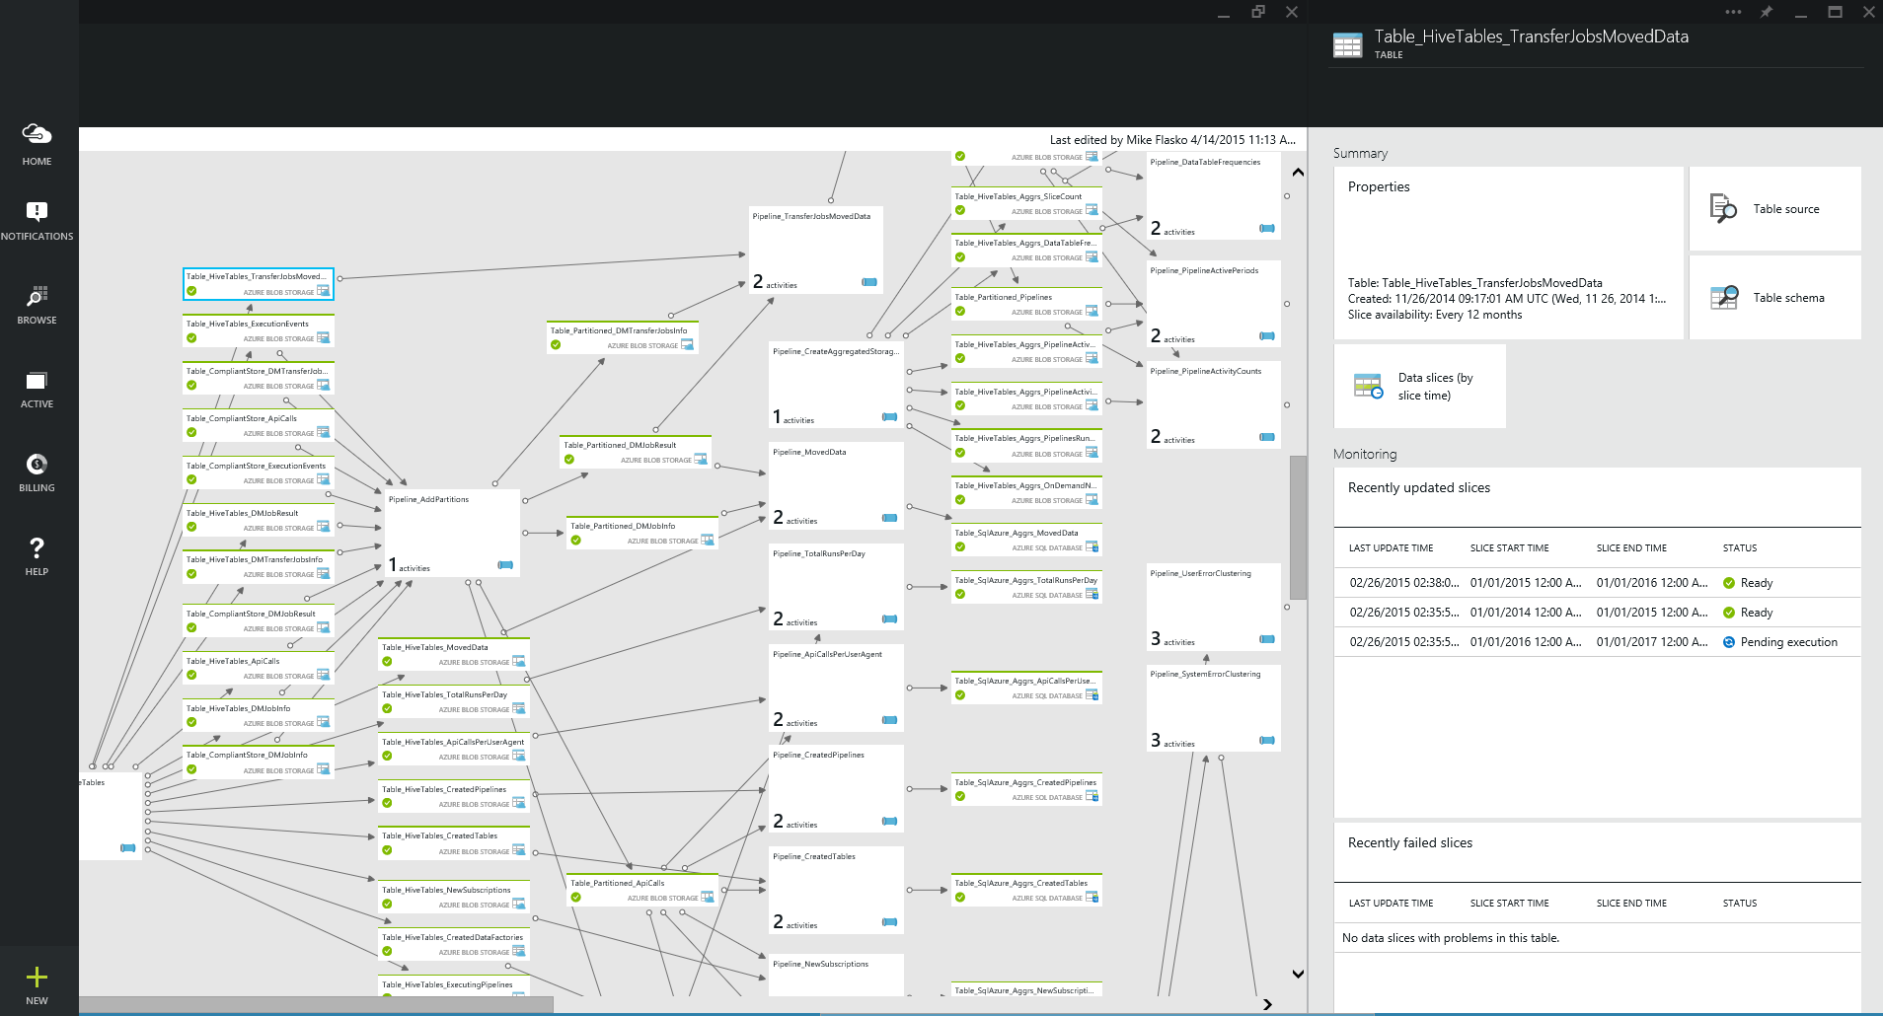
Azure Data Factory
A managed cloud service for building & operating data pipelines (aka. data flows)
Orchestrate, monitor & schedule
compose data processing, storage & movement services (on premises & cloud)
Automatic infrastructure management
combine pipeline intent with resource allocation & management
data movement as a service (global footprint & on premises)
Single pane of glass
one place to manage your network
of data flows
Notes:
Azure Data Factory is a service that helps you to orchestrate data movement. You can compose multiple services together for processing, storage, and movement both on-premises and cloud, and you can monitor and schedule these data pipelines as activities.
Another very interesting scenario is the notion of automatic infrastructure management. If you have a Hadoop cluster, you may not need it to be constantly available. Azure Data Factory can spin up a new HDInsight cluster on demand and use it during the time that you are processing, then tear it down after. This can significantly reduce the cost of Big Data projects and make them affordable for any size project.
Finally, it provides a single pane of glass to manage your entire network of data flows.

Slide 20
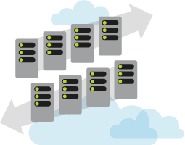
Azure SQL Data Warehouse
Cloud data warehouse that can grow, shrink, and pause in seconds
Petabyte scale with massive parallel processing
Independent scale of compute and storage in seconds
Transact-SQL queries across relational and non-relational data
Works seamlessly with Power BI, Machine Learning, HDInsight, and Data Factory
Notes:
Azure SQL Data Warehouse is the industry’s first cloud data warehouse that can grow, shrink, and pause in seconds.
It provides petabyte scale with massive parallel processing.
Scale compute and storage independently, and within seconds.
It provides TSQL queries across relational and non-relational data.
It works seamlessly with other technologies
Be sure to understand the differences between SQL DB such as no identity columns, triggers and default functions like gettime()
Note to presenter: Azure SQL Data Warehouse does not take the place of Parallel Data Warehouse (PDW) in SQL Server. This is a managed cloud service, PDW has additional features and capabilities. Azure SQL Data Warehouse has a

Slide 21



Azure Stream Analytics
Complex Event Processing of Stream Data in Azure
Small number of high volume queries
Complex Event Processing (aggregation, reduction, cleanup)
Predictable & repeatable results
SQL-like queries
Ingress Azure blobs and Event Hub
Egress to Event Hub, blobs, tables, Service Bus topics, Service Bus queues, Azure SQL Database, and Power BI
Input Adapter
Complex Event Processor
Output Adapter
Notes:
Azure Stream Analytics provides complex event processing of stream data as a service. Somewhat narrower in scope than Storm on HDInsight, Azure Stream Analytics provides a simple and very cost-effective way to process complex events. For instance, analyze streams of data for time-sequence relationships, all with a SQL-like query. Output data to Power BI to provide near-real-time reporting.

Slide 22
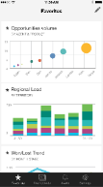
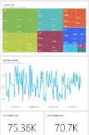
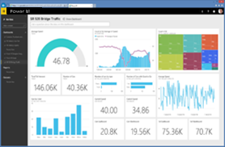
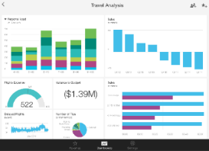

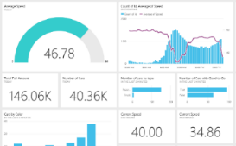


Power BI
Data sources
Power BI service
SaaS solutions
e.g. Marketo, Salesforce, GitHub, Google analytics
Content packs
Natural language query
Sharing & collaboration
On-premises data
e.g. Analysis Services
Live dashboards
Organizational content packs Corporate data sources or external data services
Visualizations
Azure services
Azure SQL, Stream Analytics…
Reports
Excel files
Workbook data / data models
01001
10101
Power BI Desktop files
Data from files, databases, Azure, and other sources
Datasets
Data refresh
Notes:
Power BI transforms your company's data into rich visuals for you to collect and organize so you can focus on what matters to you. It provides self-service BI with live dashboards, natural language queries, and integration with tools like Excel to help you visualize data.

Slide 23
Bringing it all together… connected cars scenario
Notes:
Rather than demo all of these services individually, let’s look at a scenario. Our “connected cars” scenario will bring together many parts of the Cortana Analytics Suite together to solve a real world problem.
There are many opportunities surrounding connected cars. Usage-based insurance is starting to appear today, just plug in a dongle into your car and lower your rates. Manage entire fleets for optimal routes and respond quickly to potential alert conditions. These are just a few of the business opportunities that are transforming the auto industry.
Connected car technology is split between two approaches
Put the Internet connection in the car (embedded connections)
Does not require a phone data plan to operate
Provides access to more features and data
Rely on a secondary device
Embedded connections win, because auto companies will be able to
Collect data on the performance of cars
Send updates and patches to cars remotely
Avoid recalls related to the car's software

Slide 24



Solution Architecture
Data
Ingest
Prepare
Analyze
Consume
Publish
Azure ML
Event Hub
Stream Analytics
Event Hub
Custom Dashboard Application
Data in motion
Power BI Dashboards
Data at rest
HDInsight
HDInsight
Azure ML
SQL Data Warehouse
Blob storage
Vehicle catalog
import
Data Factory: Move data, orchestrate, schedule, and monitor
Notes:
Our solution will have a car that is connected to the internet and ingests telemetry data to an Event Hub.
The data is read from the Event Hub using an Azure Stream Analytics job that outputs the data to a second Event Hub. This is done to summarize time series data. A custom dashboard application reads from the second Event Hub, enriches data using Azure ML scoring, and pushes to Power BI Dashboards for real-time visualizations. Stream Analytics also pushes the data to blob storage and a SQL Data Warehouse for analytics consumption.
The solution imports vehicle catalog data into Azure blob storage. We now want to process this using Hadoop, but don’t want to create and manage the virtual machines for the cluster. We will instead use HDInsight, a managed service that provides a scalable Hadoop installation as a service.
Rather than create an HDInsight cluster and manage the batch process scheduling ourselves, our system will instead leverage Azure Data Factory to dynamically spin up a new HDInsight cluster to prepare the data. If you have an existing cluster, you can bring your own as well. The cluster is provisioned with a “time to live” parameter.
One of the most interesting parts of the solution is the use of AzureML to detect anomalies. Azure Data Factory connects to an AzureML endpoint to score the likelihood of repair work or recalls based on anomalies detected in the data.
Finally, the data factory will move data to the Azure SQL Data warehouse, where it can be consumed from Power BI dashboards.

Slide 25
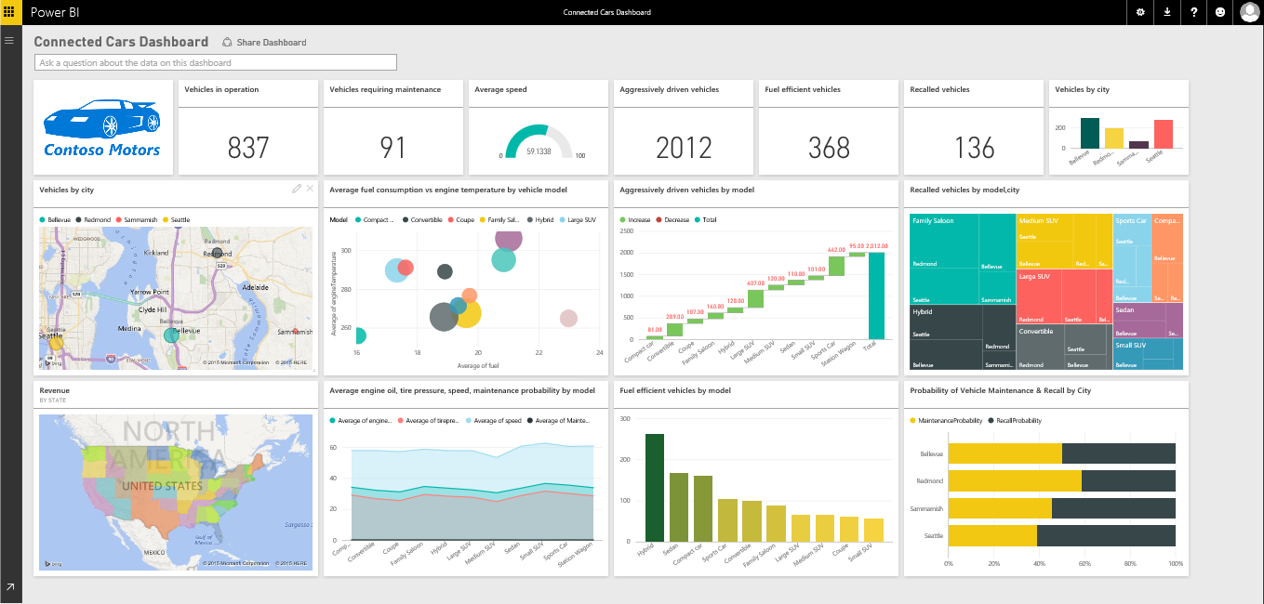
Power BI Dashboard
Notes:
The solution uses a Power BI dashboard that leverages data from the SQL Data Warehouse and real-time data from Azure Stream Analytics.

Slide 26
Connected Cars and Cortana Analytics Suite

Slide 27
Summary
Comprehensive offer for our Big Data and AA cloud portfolio
Enables a broad class of business specific scenarios
Integrates with investments in Perceptual Intelligence & Cortana
Customers can get going in individual services today
Available to transact this fall as a simple monthly subscription
Pricing and included quantities are still TBD

Slide 30
From Data to Decisions and Actions
Data
Recommendations
What should I do?
Decision
Action
Decision automation
Decision support
Predictions
What will happen?
Interactive dashboards
Why did it happen?
Static reports
What happened?
Manual process
Value

Slide 31

Cortana Analytics Suite Transform data into intelligent action
Business apps
People
Custom apps
Cortana Analytics
Sensors and devices
Automated Systems
DATA
INTELLIGENCE
ACTION

Slide 32

Cortana Analytics Suite Transform data into intelligent action
Preconfigured Solutions
Dashboards and Visualizations
Machine Learning and Analytics
Big Data Store
Information Management
Personal Digital Assistant – Cortana
Perceptual Intelligence

